Slide 1

Real World Unit Testing & Future
Raj Aththanayake.
Developer, Computershare
http://rajsoftware.com http://rajsoftware.wordpress.com
http://blog.rajsoftware.com
raj@software.com
Twitter - @raj_kba

Slide 2
Agenda
Pillars of good Unit Tests. Demo
Working with Pex and Code Contracts. Demo
Using QUnit, Sinon, JSTestDriver with VS2010. Demo
Summary.
Questions.

Slide 3

Pillars of good Unit Tests
Improve your tests readability.
Make your tests trustworthy.
Ensure tests are maintainable.

Slide 4

Demo

Slide 5

Tools for quality
Test Lint from Typemock
Find problems in your Unit Tests code.
Next version (1.5) will contain 10 additional rules.
http://site.typemock.com/test-lint/

Slide 6
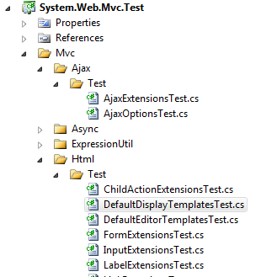


Great Unit Tests Examples
Unity
ASP.NET MVC

Slide 7

Working with Pex and Code Contracts

Slide 8
Pex and Code Contracts
Code Contracts | Pex
.NET 4.0 using C# 4.0 | Parameterised Unit Tests
Interface Contracts | Automatic Test Generation
Static Checking and Run Time Checking | IDE Integration
Documentation | Higher Code Coverage
IDE Integration

Slide 9
Writing Code Contracts
class Rational { public Rational(int n, int d) { Contract.Requires( 0 < d ); this.N = n; this.D = d; } }
Static Checking
Unit Tests
(Pex)
Runtime Checking

Slide 10
Pex and Code Contracts Basics

Slide 11
Contracts Vs Unit Testing
“Contracts are not replacement to Unit Tests.”
Unit Tests
Contracts

Slide 12

QUnit, JSTestDriver and Sinon

Slide 13

Client Side Unit Testing
EnvJS
Screw-unit
CrossCheck
YUI Test
DOH
VS 2010
QUnit
JSTestDriver
Sinon
TestSwarm
jSpec
jsSpec
FireUnit
MockMe
Jasmine
TestCase
QMock
JsUnit
Rhino Unit
jsUnity

Slide 14

QUnit
QUnit is a powerful, easy-to-use, JavaScript test suite.
Used by JQuery project to test its plugins.

Slide 15
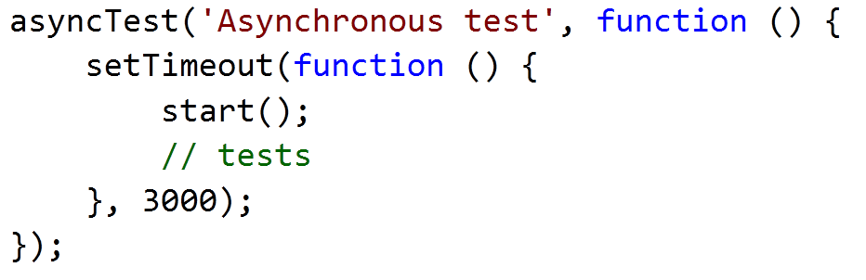
QUnit Asynchronous Tests

Slide 17
Sinon
“Standalone test spies, stubs and mocks for JavaScript. No dependencies, works with any unit testing frameworks.”
- Christian Johansen

Slide 18
Sinon
Stubs
var stub = sinon.stub(object, "method");
Mocks
var mock = sinon.mock(obj);
var expectation = mock.expects("method");
Spies
var spy = sinon.spy(myFunc);
FakeTimers, FakeXMLHttpRequest, and more…

Slide 19
Sinon Test Spies
Wraps a function.
Record the function interaction.
- spy.callCount
- spy.calledOnce
- spy.calledTwice

Slide 21
JSTestDriver
Command Line JavaScript test runner.
Allow running parallel Unit Tests executions on multiple browsers.
Provide Code Coverage.
Can integrate with GUI based JS Test runners, such as Eclipse, IntelliJ, and Maven.

Slide 22
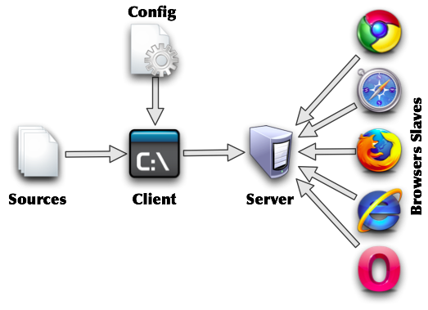

JSTestDriver automation with VS2010
Sinon

Slide 24
Summary
Good Unit Tests are readable, maintainable and trustworthy.
Basics of Contracts and Pex.
Client Side Unit Testing with QUnit, JSTestDriver, Sinon and integration to VS2010.

Slide 25


Slide 26
Thank You

